Slide 1
Flow networks
Haixu Tang
Luddy School of Informatics, Computing, and Engineering
Indiana University, Bloomington

Slide 2
Flow networks
One often uses graphs to model transportation networks: edges carry some sort of traffic; nodes act as “switches” passing traffic between different edges
a highway system: edges -- highways, nodes -- interchanges (cities),
a computer network: edges -- links carrying packets, nodes -- switches
Definition 1 A flow network is a directed graph G=(V, E) with the following features:
associated with each edge e is a capacity, a non-negative number denoted as c_{e};
there is a single source node s ∈ V;
there is a single sink node t ∈ V.
The other nodes than s and t are called internal nodes.

Slide 3
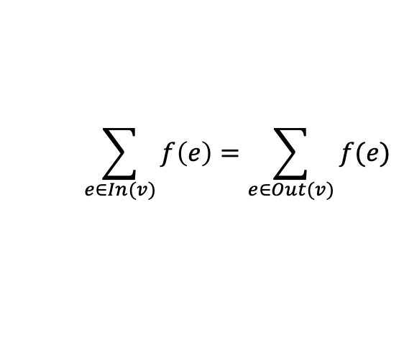
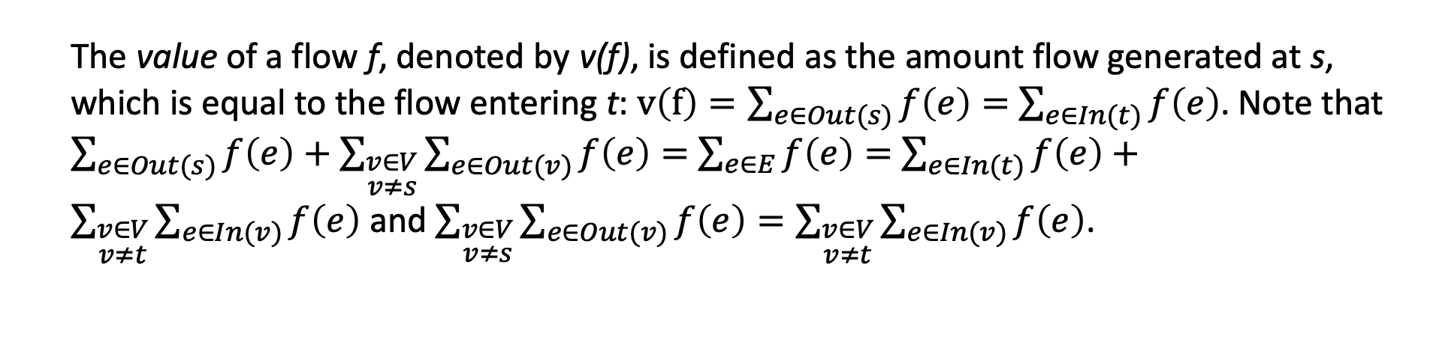
Flow in flow networks
Definition 2 In a flow network G, a flow is a function f that maps each edge e to a non-negative real number, f: E→R⁺; the value f(e) intuitively represents the amount of flow carried by edge e. A flow must satisfy the following properties:
(Capacity condition) for each e ∈ E, we have 0≤f(e)≤c_{e};
(Conservation condition) for each node v other than s and t, we have
where In(v) and Out(v) represent the set of incoming and outgoing edges incident to v, respectively.
$$\sum_{e∈In(v)}{f\left(e\right)=\sum_{e∈Out(v)}{f(e)}}$$
The value of a flow f, denoted by v(f), is defined as the amount flow generated at s, which is equal to the flow entering t: $v\left(f\right)=\sum_{e∈Out(s)}{f\left(e\right)=}$ $\sum_{e∈In(t)}{f\left(e\right)}$. Note that $\sum_{e∈Out(s)}{f\left(e\right)}+\sum_{\begin{aligned}v∈V \\ v≠s\end{aligned}}{\sum_{e∈Out(v)}{f\left(e\right)}}=$ $\sum_{e∈E}{f\left(e\right)=}$ $\sum_{e∈In(t)}{f\left(e\right)}+\sum_{\begin{aligned}v∈V \\ v≠t\end{aligned}}{\sum_{e∈In(v)}{f\left(e\right)}}$ and $\sum_{\begin{aligned}v∈V \\ v≠s\end{aligned}}{\sum_{e∈Out(v)}{f\left(e\right)}=\sum_{\begin{aligned}v∈V \\ v≠t\end{aligned}}{\sum_{e∈In(v)}{f\left(e\right)}}}$.

Slide 4
Maximum-flow problem
Maximum-flow problem. Given a flow network, find a flow of maximum possible value.
Intuition: we would like to push as much as flow from s to t.
u
flow
u
u
10
10
20
10
20
10
s
30
t
s
0
t
s
10
t
10
10
10
20
20
10
v
v
v

Slide 5
Residual network
Definition 3. Given a flow network G and a flow f, a residual network (or graph) G_{f} with respect to f is defined as,
The set of vertices is the same as G;
For each edge e=(u,v) in G on which f(e) < c_{e}, there are c_{e} – f(e) “leftover” capacity; these edges are called the forward edges;
For each edge e=(u,v) in G on which f(e) > 0, there are f(e) units of flow that we can “undo” (push backward) if we want to, thus we add an edge e’=(v,u) in G_{f} with a capacity of f(e); these edges are called the backward edges;
10
u
10
u
f
u
10
20
10
10
10
s
30
t
s
30
t
s
0
t
10
10
10
10
10
G_{f}
v
20
v
10
v

Slide 6
Augmenting path
Let P be a simple s-t path (i.e. augmenting path) in G_{f}. We define bottleneck(P, f) as the minimum residue capacity of any edge on P, w. r. t. flow f.
Below we define an algorithm to find a new flow f’ w.r.t. a given flow f and an augmenting path P, assuming b= bottleneck(P, f).
for each edge (u, v) ∈ P, if e is a forward edge, increase f(e) by b;
otherwise decrease f(e’) by b, where e’=(v, u).
Lemma 1. f’ is a flow in G.
Proof: 1) each edge e in f’ has capacity ≤ c_{e} because if e is a forward edge, f’(e)=f(e)+b ≤ f(e) + c_{e} – f(e) = c_{e} ; otherwise, f’(e)=f(e)-b≥0. 2) Let v be an internal node, the changes in the amount of flow entering v (an edge in the augmenting path) is the same as the changes of the amount of flow exiting v (the next edge in the path), depending on the types of these two edges (forward or backward).
Also, because v(f’)=v(f)+b, and b> 0, so v(f’)>v(f). That means we always improve the flow (from f to f’).

Slide 7
Ford-Fulkerson algorithm
Input G, c_{e}
Initially set f(e)=0 for all e in G
while there is a s-t path in G in the residual graph G_{f}
let P be a simple path from s to t in the residual graph G_{f}
f’←augment(f, P)
f←f’
G_{f} ← G_{f’}
Return f;

Slide 8
Ford-Fulkerson algorithm: running time
We assume all capacities in G are integers. Let the flow out from s be C= f^{out}(s)=∑_{e∈Out(s)} c_{e}, which is the maximum value of any flow.
Ford-Fulkerson algorithm terminates in at most C iterations, and each iteration takes O(m) time to find an s-t path (by using the DFS).
The run time of Ford-Fulkerson algorithm is O(mC).

Slide 9
Minimum cut problem
Definition 4 In a flow network G=(V, E), a s-t cut (A, B) is a partition of V into A and B so that s∈A and t∈B.
The capacity of a cut (A, B), c(A,B)=f^{out}(A)=∑ _{e∈Out(s)} c_{e}. The cut with the minimum capacity is called the minimum cut of G.
Minimum cut problem. Given a network G=(V, E), find the minimum cut of G.
Lemma 2. Let f be any s-t flow, and (A,B) be any s-t cut. Then v(f)=f^{out}(A)-f^{in}(A)=f^{in}(B)-f^{out}(B).
Proof: For any internal note v, f^{out}(v)-f^{in}(v)=0; so f^{out}(A)-f^{in}(A)=f^{out}(s)=v(f). Similarly, f^{in}(B)-f^{out}(B)=f^{in}(t)=v(f).
f^{out}(A)=f^{in}(B)
A
s
B
t
Corollary 1. Let f be any s-t flow, and (A,B) be any s-t cut. Then v(f)≤c(A,B).
Proof: v(f)=f^{out}(A)-f^{in}(A)≤ f^{out}(A)≤∑_{e ∈Out(A)} c_{e}=c(A,B).
f^{in}(A)=f^{out}(B)

Slide 10
Maximum flow minimum cut theorem
Maximum flow minimum cut theorem. In every flow network, there is a flow f (maximum flow) and a cut (A,B) so that v(f)=c(A,B).
Corollary 2. If f is a maximum flow in G, there exists a s-t cut (A, B) in G for which v(f)=c(A,B), and (A,B) is a minimum cut.
Proof: Let A be the set of nodes reachable by s in G_{f}, and B=V-A. All edges from a node in A to a node in B has capacity of c_{e}, and all edges from a node in B to a node in A has a capacity of 0. v(f)= f^{out}(A)-f^{in}(A)= ∑_{e∈out(A)} c_{e}=c(A,B), i.e., c(A,B) reaches the upper bound v(f).
f^{out}(A)=f^{in}(B)
Ford-Fulkerson algorithm (or any algorithm for maximum flow problem) can be used to find a minimum cut in a flow network.
A
s
B
t
Note: this theorem is not dependent on Ford-Fulkerson algorithm, and thus does not require the capacities to be integers.
f^{in}(A)=f^{out}(B)=0

Slide 11
Ford-Fulkerson algorithm in practice
u
100
100
s
1
t
100
100
v
Flow network

Slide 12
Ford-Fulkerson algorithm in practice
u
100(0)
100(0)
s
1(0)
t
100(0)
100(0)
v
Initial flow f

Slide 13
Ford-Fulkerson algorithm in practice
u
u
100(0)
100(0)
100
100
s
1(0)
t
s
1
t
P
100(0)
100(0)
100
100
v
v
b=100
Initial flow f
Residual graph G_{f}

Slide 14
Ford-Fulkerson algorithm in practice
u
u
100(100)
100(100)
100
100
s
1(0)
t
s
1
t
100(0)
100(0)
100
v
100
v
Flow f
Residual graph G_{f}

Slide 15
Ford-Fulkerson algorithm in practice
u
u
100(100)
100(100)
100
100
s
1(0)
t
s
1
t
P
100(0)
100(0)
100
v
100
v
b=100
Flow f
Residual graph G_{f}

Slide 16
Ford-Fulkerson algorithm in practice
u
u
u
100(100)
100(100)
100(100)
100(100)
100
100
s
1(0)
t
1
s
1(0)
t
s
t
100(100)
100(100)
100
100(100)
100(100)
v
100
v
v
Flow f
Max Flow f
Residual graph G_{f}
No augmenting path – algorithm stops!
Only two iterations!

Slide 17
Ford-Fulkerson algorithm in practice (unlucky)
u
100(0)
100(0)
s
1(0)
t
100(0)
100(0)
v
Initial flow f

Slide 18
Ford-Fulkerson algorithm in practice (unlucky)
u
u
u
100(0)
100(0)
100
100
100(1)
100(0)
s
1(0)
t
s
1
t
s
1(1)
t
P
100(0)
100
100
100(0)
100(1)
100(0)
v
v
v
b=1
Initial flow f
Residual graph G_{f}
Improved flow f’
v(f) increases 1

Slide 19
Ford-Fulkerson algorithm in practice (unlucky)
u
u
u
100(1)
100(100)
99
100
100(1)
100(1)
P
s
1(0)
t
s
1(1)
t
s
1
1
t
100(0)
100
99
100(1)
100(1)
100(1)
1
v
v
v
b=1
Flow f
Improved flow f’
v(f) increases 1
Residual graph G_{f}
Need 200 iterations in the worst case! Worst case run time: O(mC), slow when C >> m.

Slide 20
Scaling Max-flow Algorithm
Better choose augmenting paths with large bottleneck capacity
Augmentation increases the value of maximum flow by the bottleneck capacity of the augmenting path
However, to find the path with the largest bottleneck capacity is hard.
We will select a path with relatively large capacity, i.e., we maintain a scaling parameter Δ, and look for paths that have bottleneck capacity of at least Δ.

Slide 21
Scaling Max-flow Algorithm
Initially set f(e)=0 for all e in G
Set Δ to be the largest power of 2 that is smaller than C.
while Δ≥1
while there is a s-t path in G in the residue graph G_{f}(Δ)
let P be a simple path from s to t in the residue graph G_{f}(Δ)
f’←augment(f, P)
f←f’
G_{f}(Δ) ← G_{f’}(Δ)
Δ←Δ/2
Return f;
G_{f}(Δ): the subgraph of residual graph G_{f} with capacity ≥Δ: any augmenting path in this subgraph has bottleneck capacity ≥Δ.
Δ=powers of 2, and decrease it by half if cannot find an augmenting path in G_{f}(Δ).
The number of iterations of the outer loop is at most 1+ ⎣log₂C⎦.
Within each inner loop, the flow value increases by at least Δ.
Let f be the flow at the end of each inner loop. The maximum flow in the network has a value at most v(f)+mΔ, because the remaining capacity for each edge is at most Δ after the inner loop.
Run time: O(m² logC)
Corollary. The number of augmentations in the scaling phase is at most 2m.
Proof: in last scaling phase, Δ’=2Δ. Let f_{p} be the flow at the end of the last phase, the maximum value flow f* is v(f*)≤v(f_{p})+mΔ’= v(f_{p})+2mΔ. In the current scaling phase, each augmentation will increase the value of flow by at least Δ, so there are at most 2m augmentations.
When C >> m, much faster than O(mC).

Slide 22
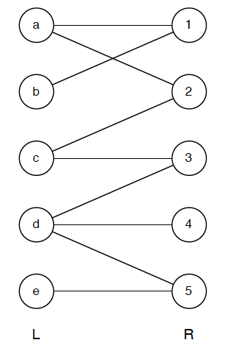
Applications: Bipartite Matching Problem
Bipartite graph: a graph whose vertices can be divided into two independent sets, U and V such that every edge (u, v) either connects a vertex from U to V or a vertex from V to U.
A matching in a Bipartite graph: a set of the edges chosen in such a way that no two edges share an endpoint.
Ex: to pair friends in a dancing party
Maximum matching: a matching of maximum size (maximum number of edges).
If any edge is added to a max matching, it is no longer a matching.
There can be more than one maximum matchings for a given Bipartite Graph.
Bipartite Matching Problem: Given a bipartite graph, find a maximum matching in it.

Slide 23
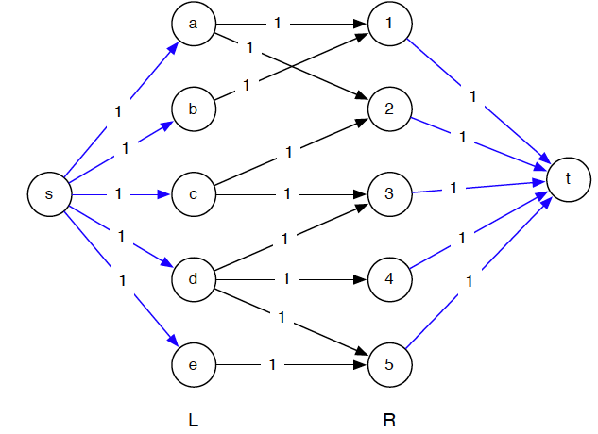
Applications: Bipartite Matching Problem
Bipartite Matching Problem: Given a bipartite graph, find a maximum matching in it.
Theorem. The size of the maximum matching in G is equal to the value of the maximum flow in G’; and the edges in such a matching in G are the edges that carry flow from s to t in G’.
Ford-Fulkerson algorithm to solve it.
G: |V|=2n, |E|=m → G’: |V|=2n+2, |E|=m+2n
Run time: O(n(m+n))

Slide 24
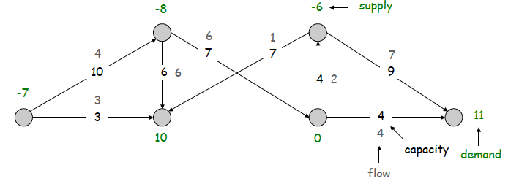
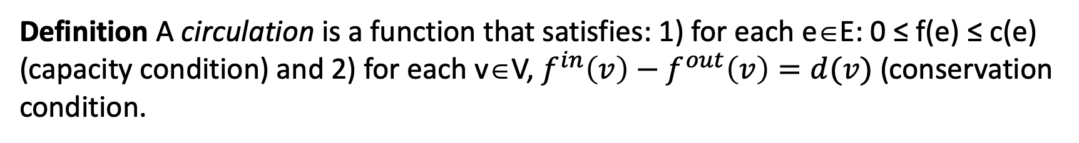
Application: Circulation with supplies and demands
Definition A directed graph G=(V,E) with supplies and demands is defined as a directed graph, with 1) edge capacities c(e), for each e∈E, and 2) node supply and demands d(v), v∈V: if d(v)=0, we call the node transshipment; if d(v) > 0, we call it demand; if d(v) < 0, we call it supply.
Definition A circulation is a function that satisfies: 1) for each e∈E: 0 ≤ f(e) ≤ c(e) (capacity condition) and 2) for each v∈V, $f^{in}\left(v\right)−f^{out}\left(v\right)=d(v)$ (conservation condition.
Circulation problem: given (V, E, c, d), is there a feasible circulation?

Slide 25
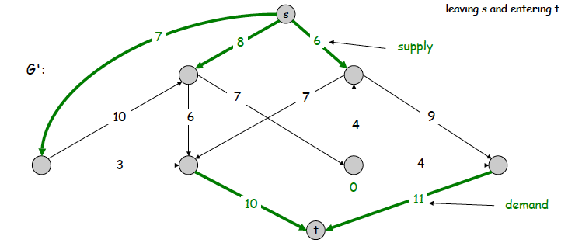
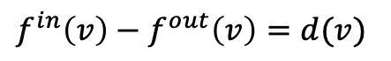
Application: Circulation with supplies and demands
Circulation problem: given (V, E, c, d), is there a feasible circulation?
Lemma (Necessary condition) if there is a feasible circulation with demands {d(v)}, then ∑_{v}d(v)=0.
$f^{in}\left(v\right)−f^{out}\left(v\right)=d(v)$
Convert circulation problem into a maximum flow problem. Given G=(V,E), c and d, we build a flow network G’ by
adding new source s and sink t;
for each v with d(v) < 0, adding edge (s, v) with capacity -d(v);
for each v with d(v) > 0, adding edge (v, t) with capacity d(v).

Slide 26
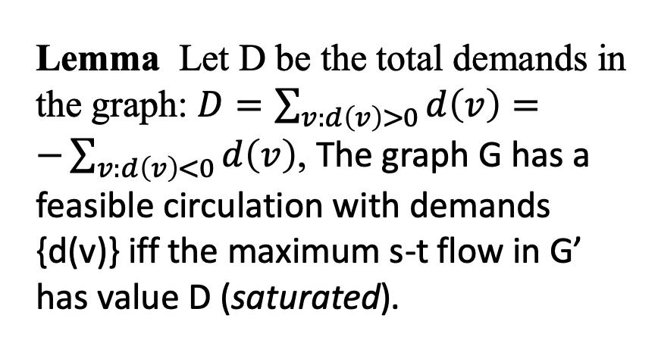
Application: Circulation with supplies and demands
Lemma Let D be the total demands in the graph: $D=\sum_{v:d\left(v\right)>0}{d\left(v\right)=}$
$−\sum_{v:d\left(v\right)<0}{d\left(v\right)}$, The graph G has a feasible circulation with demands {d(v)} iff the maximum s-t flow in G’ has value D (saturated).

Slide 27
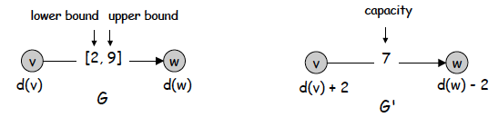
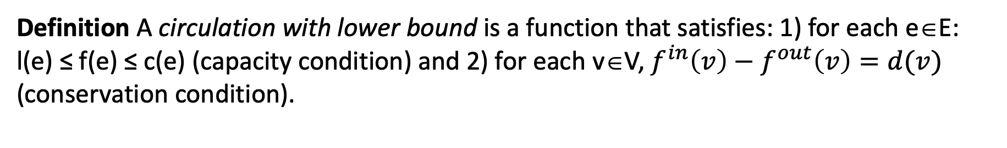
Application: Circulation with lower bound
Definition A circulation with lower bound is a function that satisfies: 1) for each e∈E: l(e) ≤ f(e) ≤ c(e) (capacity condition) and 2) for each v∈V, $f^{in}\left(v\right)−f^{out}\left(v\right)=d(v)$ (conservation condition).
Circulation problem: given (V, E, c, l, d), is there a feasible circulation?
Solution: convert circulation with lower bound problem into a circulation problem (i.e., modeling lower bound by demands).

Slide 28
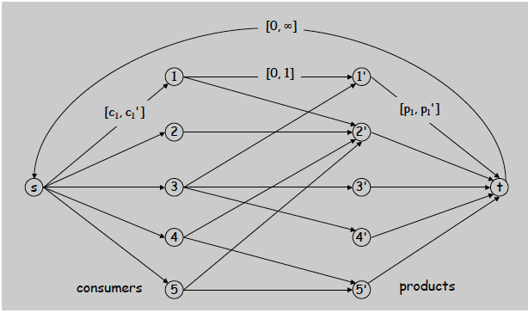
Application: Survey design problem
Design survey asking n₁ consumers about n₂ products. We can only survey consumer i about product j if they own it. We ask consumer i between c_{i} and c_{i'} questions, each for a different product, and ask between p_{j} and p_{j'} consumers about product j. Goal: design a survey that meets these specifics, if possible.
Special case: when c_{i} = c_{i'} = p_{i} = p_{i'} = 1, the problem can be formulated as a bipartite matching problem.
Solution: Formulated as a circulation problem with lower bounds: include an edge (i, j) if consumer j owns product i, a circulation←→feasible survey design.

Slide 29
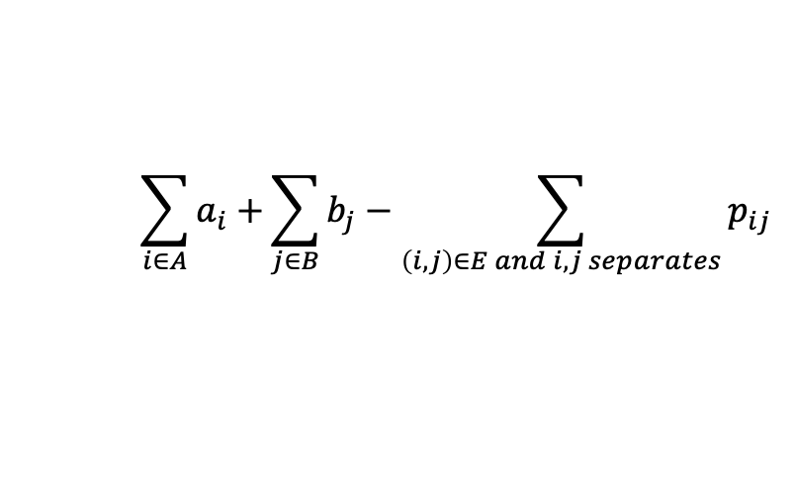
Application: Image Segmentation Problem
To divide image into coherent regions, e.g., three people standing in front of complex background scene, to identify each person as a coherent object.
Problem formulation: foreground / background segmentation.
label each pixel in picture as belonging to foreground or background.
V = set of pixels, E = pairs of neighboring pixels.
a_{i} ≥ 0 is likelihood pixel i in foreground; b_{i} ≥ 0 is likelihood pixel i in background.
p_{ij} ≥ 0 is separation penalty for labeling one of two neighboring pixels i and j as foreground, and the other as background.
Goals: 1) Accuracy: if a_{i} > b_{i} in isolation, prefer to label i in foreground.
2) Smoothness: if many neighbors of i are labeled foreground, we should be inclined to label i as foreground.
Image Segmentation Problem Given an image graph and (a, b, p), find a partition (A=foreground, B=background) that maximizes:
$$\sum_{i∈A}{a_{i}+}\sum_{j∈B}{b_{j}−\sum_{\left(i,j\right)∈E and i,j separates}{p_{ij}}}$$

Slide 30
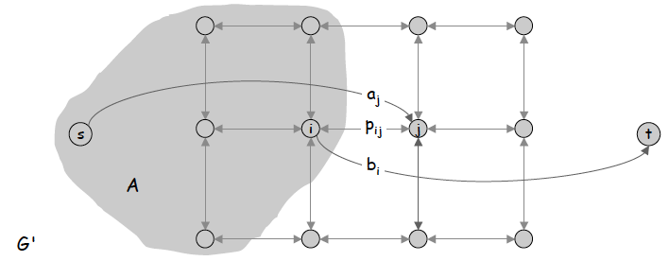
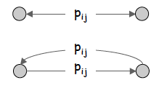
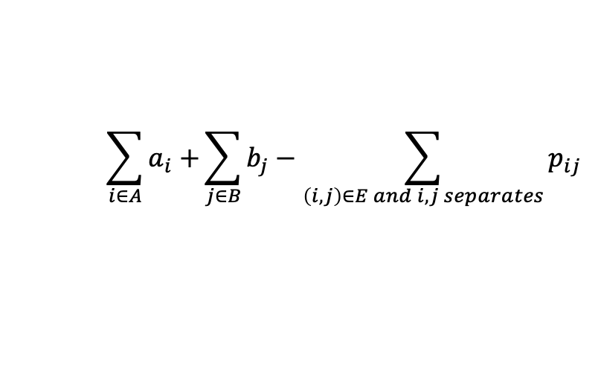
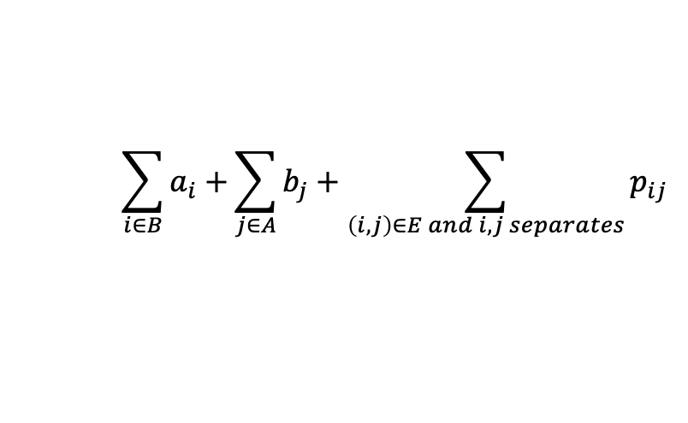
Application: Image Segmentation Problem
Image Segmentation Problem Given an image graph and (a, b, p), find a partition (A=foreground, B=background) that maximizes:
$$\sum_{i∈A}{a_{i}+}\sum_{j∈B}{b_{j}−\sum_{\left(i,j\right)∈E and i,j separates}{p_{ij}}}$$
Equivalent to minimize:
$$\sum_{i∈B}{a_{i}+}\sum_{j∈A}{b_{j}+\sum_{\left(i,j\right)∈E and i,j separates}{p_{ij}}}$$
Solution: Formulating it as a minimum cut problem:
G' = (V', E').
add source to correspond to foreground;
add sink to correspond to background;
use two anti-parallel edges instead of undirected edge.
Then the minimum cut (A,B) have the minimum score as indicated above.

Slide 31
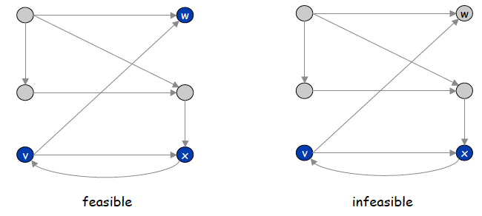
Application: Project selection Problem
We are given a set of projects with prerequisites
1) Set P of possible projects. Project v has associated revenue p(v): some projects generate money: create interactive e-commerce interface, redesign web page; others cost money: upgrade computers, get site license
2) Set of prerequisites E. If (v, w) ∈ E, can't do project v and unless also do project w.
3) A subset of projects A ⊆ P is feasible if the prerequisite of every project in A also belongs to A.
Goal: choose a feasible subset of projects to maximize revenue.
Problem formulation: build a prerequisite graph: each vertex represents a project; include an edge from v to w if can't do v without also doing w, then {v, w, x} is feasible subset of projects; {v, x} is infeasible subset of projects.

Slide 32
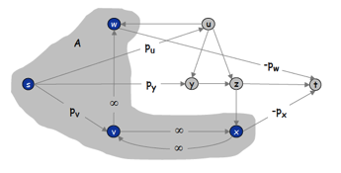
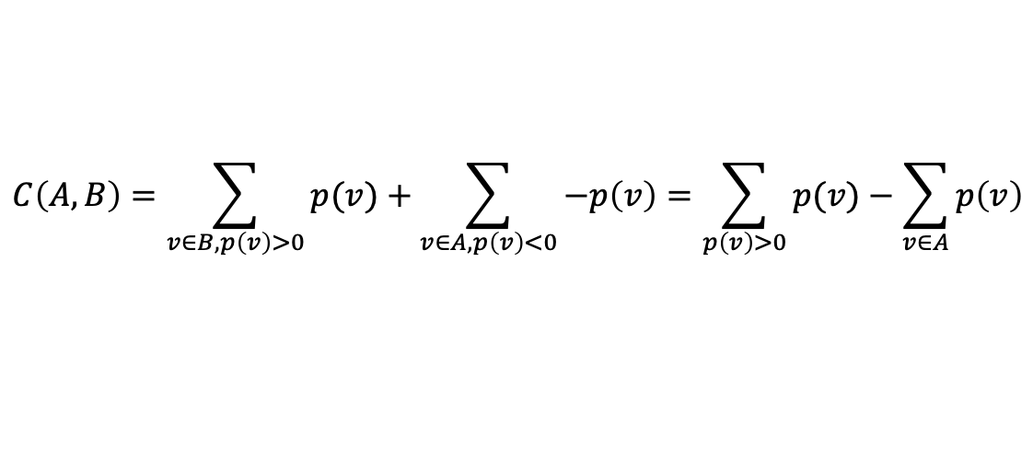
Application: Project selection Problem
Problem formulation: build a prerequisite graph: each vertex represents a project; include an edge from v to w if can't do v without also doing w, then {v, w, x} is feasible subset of projects; {v, x} is infeasible subset of projects.
Solution: convert to a Minimum Cut Problem: constructing the flow network of G’
1) Assign capacity ∞ to all prerequisite edge.
2) Add two nodes s, t.
2) Add edge (s, v) with capacity p(v) if p(v) > 0.
3) Add edge (v, t) with capacity –p(v) if p(v) < 0.
Theorem The cut (A, B) in G’ is minimum iff A-{s} is the optimal set of projects.
Proof: 1) infinite capacities on prerequisite edges (both in A or both in B ensure A-{s} a feasible subset of projects; and 2) the revenue is maximized because the capacity of the cut is minimized:
$$C\left(A,B\right)=\sum_{v∈B,p\left(v\right)>0}{p(v)}+\sum_{v∈A,p\left(v\right)<0}{−p\left(v\right)}=\sum_{p\left(v\right)>0}{p(v)}−\sum_{v∈A}{p\left(v\right)}$$

